Slide 1
Business Tier with Microservices and APIs
Praveen Kumar
Computer Science and Engineering
Ohio State University
Notes:
Welcome to the lecture on business tier with Microservices and API. The goal for today is get a good understanding of the role played by business tier in an enterprise application, and how you can build it using microservices.

Slide 2
Agenda
Introduction to APIs
Business tier overview
Miscellaneous concepts
Summary
Introduction to microservices
Building microservices with RESTful APIs
Notes:
The agenda for today is:

Slide 3
Part 1 of 5 – Overview of Business tier
Notes:
Let’s begin with part 1 – an overview of business tier

Slide 4
Business Tier Overview
Role/Purpose
Consolidate business logic
Encapsulate / hide complexity
Decouple from presentation tier
Separate from rate of change
Avoid mixing of concerns
Non-functional requirements
Transaction
Security
Orchestration / business workflow
Presentation Tier
Business Logic Tier
Integration Tier
System Component Tier
Application Architecture
Notes:
If you recall our discussion a previous lecture on application architecture fundamentals, - we said that a modern application is made up of logical tiers. That diagram is shown here.
In the last two weeks, you learned about the presentation tier.
This week, we will learn about the business tier.
The key roles played by the business tier in an application are:
Consolidate business logic. This means, that domain functional logic is in one place where it can be easily maintained and managed.
Encapsulate or hide complexity, especially from the presentation tier. By doing that you enable the presentation tier to focus on effective interaction with the user and let the business tier worry about what user is allowed to do, and what is the result of their request
Decouple from the presentation tier. There are two aspects of this decoupling. The first aspect is that the business tier is separated from the rate of change in the presentation tier. As you all know, the requirements for user interaction evolve all the time, however business logic remains relatively more stable. The second aspect is that you avoid the mixing of concerns (i.e., user interaction vs. the business logic) across the two tiers.
There are certain non-functional requirements that are very important to the business tier. They are transaction, security (i.e., authorization), and orchestration or business workflow. A framework or container supporting the business tier must provide the underpinning to handle these requirements.

Slide 5
Business Tier Overview (contd.)
Architectural considerations
Reuse across applications
Deployment choice
Distributed vs. Non-distributed
Scalability & clustering
Performance: granular interfaces
Stateful vs. Stateless (conversational state)
Location transparency
Notes:
Continuing our discussion on the business tier, let's talk about certain architectural considerations.
The first is reuse across applications. If the business logic is encapsulated well, and is designed to be presentation logic agnostic, it is quite possible – and in fact, it is quite common – to reuse this business logic across multiple presentation applications.
The second consideration is deployment choice. You can embed the business tier inside the applications that provide user interface, as a library. That will be considered a non-distributed deployment. Or, alternatively you can deploy the business tier as its own application on a separate server. This application will not have any user interface, and you can consider it as a “headless” application.
The third consideration is scalability and clustering. If the user base, and number of application using the business tier is increasing, then you should consider distributed deployment of the business tier with a cluster of servers with reverse proxy.
The fourth consideration is that of performance. If you choose a distributed deployment, then presentation application will have to make remote call to the business tier, which may have time lag. In order to improve performance, you need to consider coarse-grained methods, and avoid very chatty interaction.
The fifth architectural consideration is stateful vs. stateless. A stateful business tier maintains the conversational state with the client. Think about a shopping cart. Assume that it is maintained in the business tier. The presentation tier will continue to add/remove/modify items to the shopping cart through a series of interactions. The business tier must remember the entire conversation for each client, separately. The stateless tier does not remember any client state, and therefore treats each request as an independent one. Consider an example of an inquiry, such as the current weather details, from a business tier server. There is no client conversation to remember. You should choose stateful or stateless business tier based on the nature of business functionality that you are developing.
The sixth consideration is the location transparency. Do you want the presentation applications to be unaware of the location of where the business logic is? If yes, consider distributed business tier, and a ubiquitous way to locate the business tier objects, such as Java Naming and Directory Interface or JNDI.

Slide 6
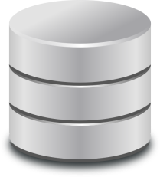
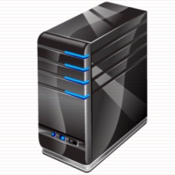
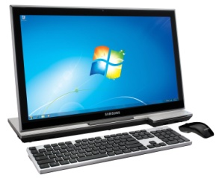
Business Tier – Distributed vs. Non-Distributed
Presentation
Bus Logic
Client
Data
Presentation
Bus Logic
Client
Data
Notes:
Let’s now use a couple of diagrams to understand how distributed vs. non-distributed business tier looks like.
The first diagram illustrates the example of non-distributed deployment of business tier. As you can see the presentation and business logic both are deployed inside a single application on a server or a cluster of servers. Note that presentation tier and busines tiers were developed separately, they are just DEPLOYED together.
The second diagram (at the bottom that is) illustrates the example of distributed deployment of the business tier.
Hopefully, you now have a clear understanding of distributed vs. non-distributed business tier.
Let’s move on to the next topic, which is how to build business tier

Slide 7
Part 2 of 5 – Introduction to Microservices
Notes:
Lets move onto part 2, an introduction to micro services

Slide 8
Monolith Applications
The entire business logic can be built as a singular, self-sufficient application called monolith
Traditional style, application contains lots of functionality and business logic
Complex, expensive to change and evolve
Risk of falling into big ball of mud anti-pattern
User Interface
Payment Business Logic
Order Processing Business Logic
Shipping Business Logic
Data Access
Database
An Example Monolith
Notes:
One way to build applications is to contain the entire business logic into a singular, self-sufficient application called monolith.
Here is an example monolith used for eCommerce. It has a user interface. It has a business tier which contains business logic to support three functions – customer order processing, handling payments, and handling shipping of items that the customer ordered online. It has a set of data access objects that business tier uses to interact with a database shown here. The business tier objects tend to be tightly coupled.
Such applications were built during early days of software development, and they are still commonplace in large enterprises. That’s is why you can call them the traditional style, where the monolith application contains lots of functionality with lots of business logic in one place.
In this example, the number of functionalities supported by the business tier in THREE. In real-life, that can be dozens. What will be the result?
A lot of objects in the business tier, right! How about complexity? And coupling among those objects? VERY HIGH, right?
The monoliths are complex, and they are expensive to change and evolve.
There is an inherent risk of falling into big ball of mud anti-pattern, meaning that code will likely proceed towards spaghetti-code jungle.

Slide 9
Microservices
An architecture style to build applications using small, loosely-coupled services
Connectivity via a well-defined interface called API
Typically organized by business capability, referred to as bounded context
Independent tech stack, data storage & deployment
User Interface
API
API
API
Payment Business Logic
Order Processing Business Logic
Shipping Business Logic
Data Access
Data Access
Data Access
Database
Database
Database
A Microservice
An Example of Microservices Architecture
Coupled Microservices ➔ Distributed Monolith!!

Slide 10
Characteristics of Microservices Architecture
Componentization via Services
Organized around Business Capabilities
Products not Projects
Smart endpoints and dumb pipes
Decentralized Governance
Decentralized Data Management
Infrastructure Automation
Design for failure
Evolutionary Design
Credits: https://martinfowler.com/articles/microservices.html

Slide 11
Benefits/Costs of Microservices
Benefits
Costs
Reinforces strong modular boundaries – great for large organizations with multiple teams
Independent deployment & precise scaling
Supports technology diversity – enabling evolution & fit for purpose solutions
Complexity of distributed computing – remote calls, risks of failure etc.
Operational complexity –preventive & corrective maintenance, monitoring, troubleshooting, redeployment etc.

Slide 12
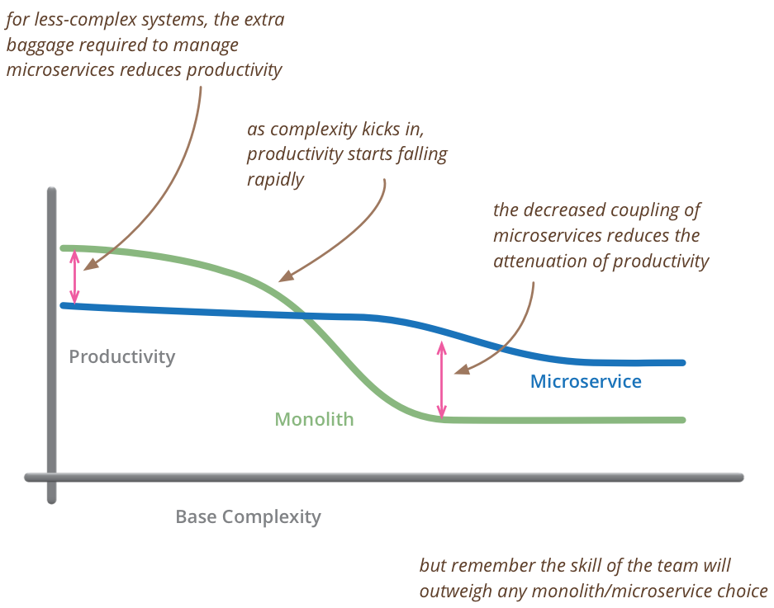
When to use Microservices?
Image source: https://martinfowler.com/bliki/MicroservicePremium.html

Slide 13
Part 3 of 5 – Introduction to APIs
Notes:
Lets move onto part 2, an introduction to micro services

Slide 14

API
API stands for Application Programming Interface
It is a combination of protocol and methods that define how an application’s functionality and data can be accessed
In today’s hyperconnected world, APIs play a key role. However, the protocol & methods need to be standardized to enable ubiquitous connectivity

Slide 15
Web API (a.k.a. REST API)
A standard way to specify API for an application (monolith or microservices)
The 3 standards are:
Protocol | HTTP
Methods | GET, POST, PUT, DELETE, HEAD, CONNECT, OPTIONS, TRACE
Format of input/output data | JSON (JavaScript Object Notation)
REST – Representative State Transfer; an architectural style using HTTP

Slide 16
Web API Methods
GET – get a single item or a collection
POST – add an item to a collection
PUT – edit an item that exists in a collection
DELETE – delete an item in a collection
...
These methods (actions) become universal interface to the business tier functionality

Slide 17
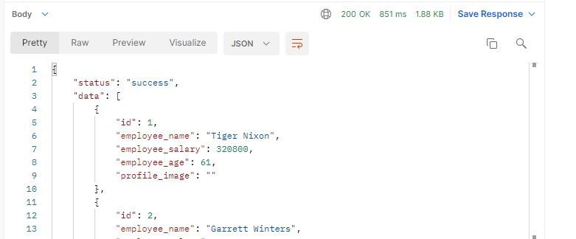
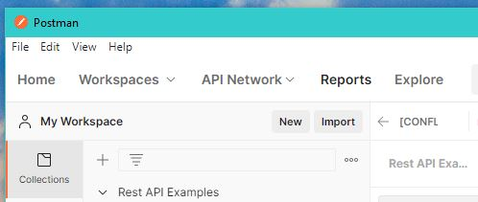
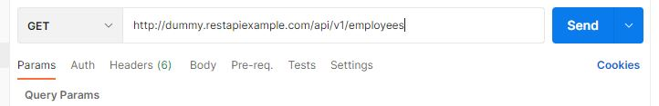
API Example
Download and install Postman application
Create new Http Request (File > New)
Method: GET
URI: http://dummy.restapiexample.com/api/v1/employees

Slide 18
OpenAPI Specification (OAS)
A standard, language-agnostic way to describe RESTful APIs
Makes it easy for all consumers to understand and interact with an API
Clients and servers can both take advantage of automated code generation tools
OpenAPI Specification (OAS) document can be easily passed around and processed
https://github.com/OAI/OpenAPI-Specification/tree/main/examples/v3.0

Slide 19
API Gateway
API Gateway
Monolith 1
API
Web Application
API
API
Mobile Application
API
Microservice 1
3rd party Application
Microservice 2
API
Single entry point for all APIs available in the enterprise (implemented by monoliths or microservices)
Client applications do not know or care about implementation
Value Add – security, call routing, location transparency

Slide 20
API-First Approach
It is a philosophy used in Enterprises
API design comes before any implementation
Team builds robust API before any UI
API is application’s first interface!
Benefits of API-First in a large enterprise
Parallel software development
Accelerated development / reduced risk of failure
Optimized development costs
Improved developer/team satisfaction

Slide 21

Do you have an API for that?

Slide 22
Part 4 of 5 – Building Microservices with RESTful APIs
Notes:
Lets move onto part 2, an introduction to micro services

Slide 23
Development Frameworks
Java Based
Spring Boot
Restlet
Spark
Dropwizard
Python Based
Flask
Falcom
Bottle
Nameko
CherryPy
Golang (Go Language) based
GoMicro
Go Kit
Node JS based
.NET

Slide 24

Java Based Frameworks
All Java based frameworks use the same foundational JEE components (i.e., specs)
JAX-RS
JSON-P & JSON-B
Context and Dependency Injection (CDI)

Slide 25
JAX-RS
Stands for Java API for RESTful Web Services
Microservices are deployed within a web application, with a pre-defined singular servlet: javax.ws.rs.core.Application
You must configure an application path
@ApplicationPath("/servicename")
public class MyApplication extends javax.ws.rs.core.Application {
...
}

Slide 26
JAX-RS (contd.)
You can use a simple Java class (POJO) as a microservice by configuring its methods as RESTful API
@Path("/helloworld")
public class HelloWorld {
@GET
@Path("/hello")
public Response hello() {
return Response.ok().entity(“Hello World!").build();
}
}
https://docs.oracle.com/javaee/7/tutorial/jaxrs002.htm

Slide 27
JSON-P & JSON-B
Libraries for JEE applications to deal with JSON & convert to/from Java objects
Part of JAX-RS 2.0+ specification
private static final Jsonb jsonb = JsonbBuilder.create();
// Convert POJO --> JSON
User andy = new User(1234, "Andy", 77, Collections.singleton("admin"));
String andyJson = jsonb.toJson(andy);
System.out.println(andyJson); // prints: {"age":77,"id":1234,"name":"Andy","roles":["admin"]}
// Convert JSON --> POJO
String jsonData = "{\"age\":55,\"id\":5678,\"name\":\"Hank\",\"roles\":[\"member\"]}";
User hank = jsonb.fromJson(jsonData, User.class);
Source: https://openliberty.io/docs/21.0.0.9/json-p-b.html

Slide 28
JAX-RS Implementations
Apache CXF
Jersey (reference implementation)
RESTeasy (JBoss)
Restlet
WebSphere Application Server (IBM)
WebLogic Application Server (Oracle)
Everrest
Jello-Framework
Apache TomEE (add-on to Apache Tomcat)

Slide 29
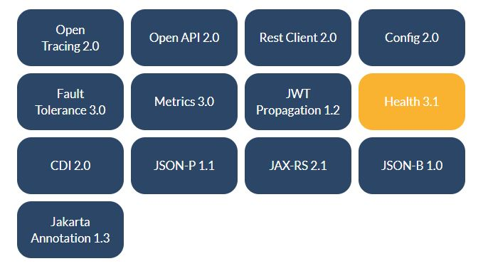
Eclipse Micro Profile
A modular set of technologies to develop cloud-native Java microservices at scale
Core Java EE

Slide 30
Part 5 of 5 – Miscellaneous Concepts
Notes:
Lets move onto part 2, an introduction to micro services

Slide 31
Key Enabling Technologies
Key Enabling technologies for Microservices based architecture are:
Containers, Docker, and Kubernetes
API Gateways
Messaging & event streaming
Serverless
Microservices both enable, and require DevOps

Slide 32



Future (and Present) of Software Architecture
Leading companies have adopted microservices approach
Underlying principle – break an application’s tasks into software subcomponents
Microservices & APIs are shaping not just how software works together, but also how people collaborate

Slide 33
What have we learned?
1
2
Microservices
3
APIs
Business tier
4
Building Microservices with RESTful APIs
Key enabling technologies
5
Future of software architecture
6

Slide 34
References
Lewis, James and Fowler, Martin, 2014. Microservices – A definition of this new architectural term. Retrieved August 2021, from: https://martinfowler.com/articles/microservices.html
Fowler, M., 2015. Microservices Trade-Offs. Retrieved August 2021, from: https://martinfowler.com/articles/microservice-trade-offs.html
Microservice Architecture. Retrieved August 2021, from: https://microservices.io/index.html
Notes:
Here are a few references, which will help you get a deeper understanding of topics.

Slide 35
Appendix
Notes:
Lets move onto part 2, an introduction to micro services

Slide 36
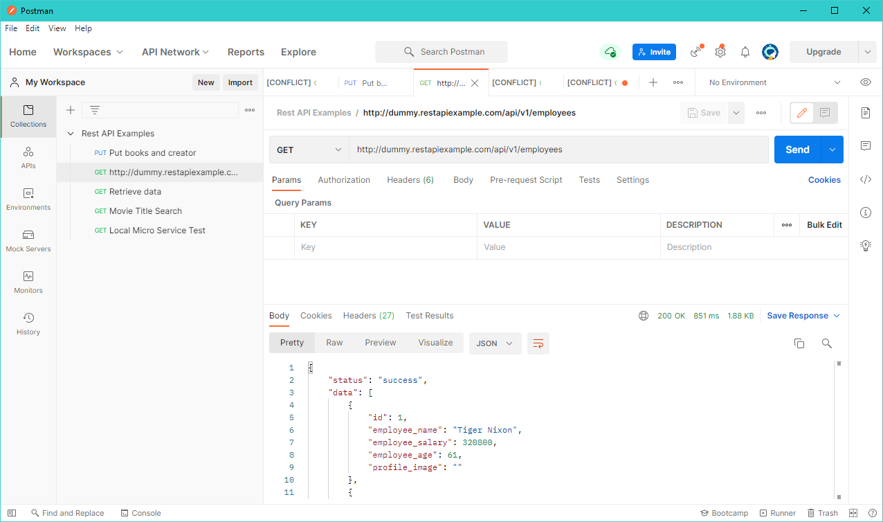
API Example (full screenshot)

Slide 37
OAS Example (snippets)
openapi: 3.0.0
info:
title: Callback Example
version: 1.0.0
paths:
/streams:
post:
description: subscribes a client to receive out-of-band data
parameters:
- name: callbackUrl
in: query
required: true
description: |
the location where data will be sent. Must be network accessible
by the source server
schema:
type: string
format: uri
example: https://tonys-server.com
responses:
...
...
https://github.com/OAI/OpenAPI-Specification/tree/main/examples/v3.0

